Slide 1
Hypothesis Testing: t test

Slide 2
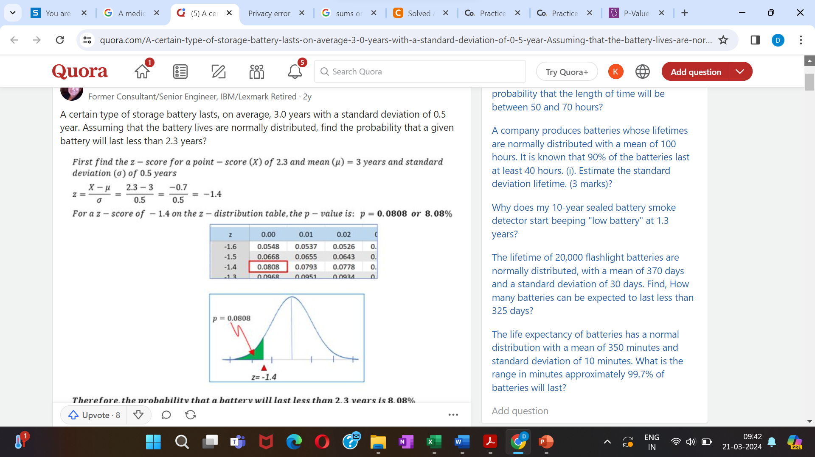

Slide 3
Example: The test scores of students in a class test has a mean of 70 and with a standard deviation of 12. What is the probable percentage of students scored more than 85?
Solution: The z score for the given data is,
z= (85-70)/12=1.25
From the z score table, the fraction of the data within this score is 0.8944.
This means 89.44 % of the students are within the test scores of 85 and hence the percentage of students who are above the test scores of 85 = (100-89.44)% = 10.56 %.

Slide 4
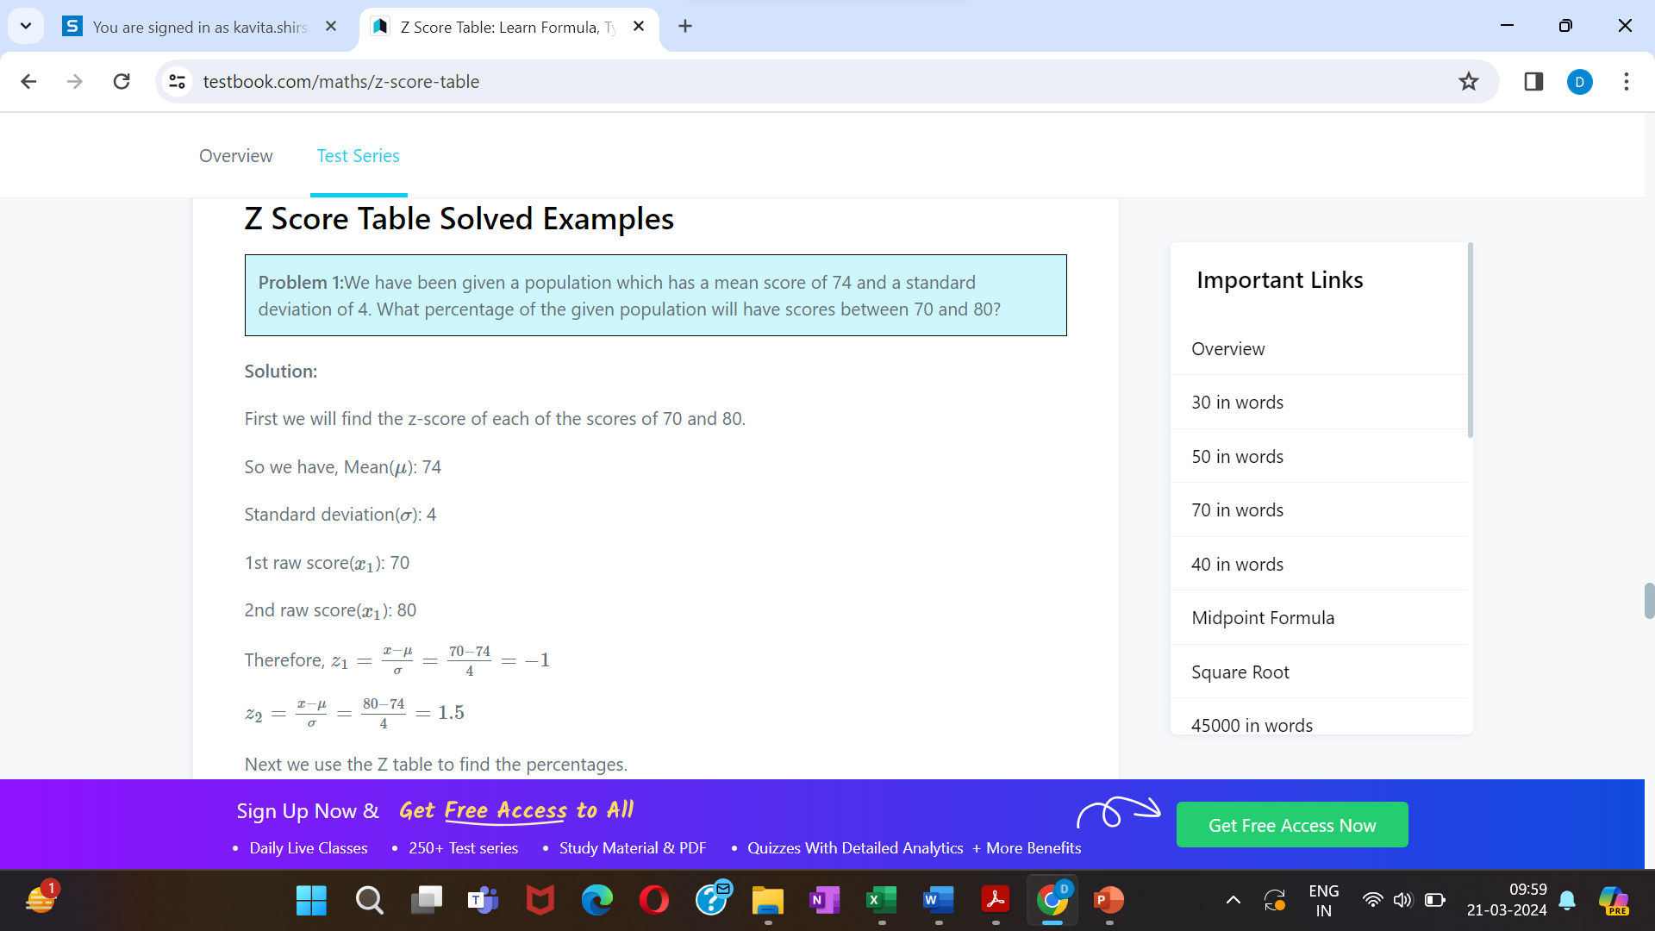

Slide 5
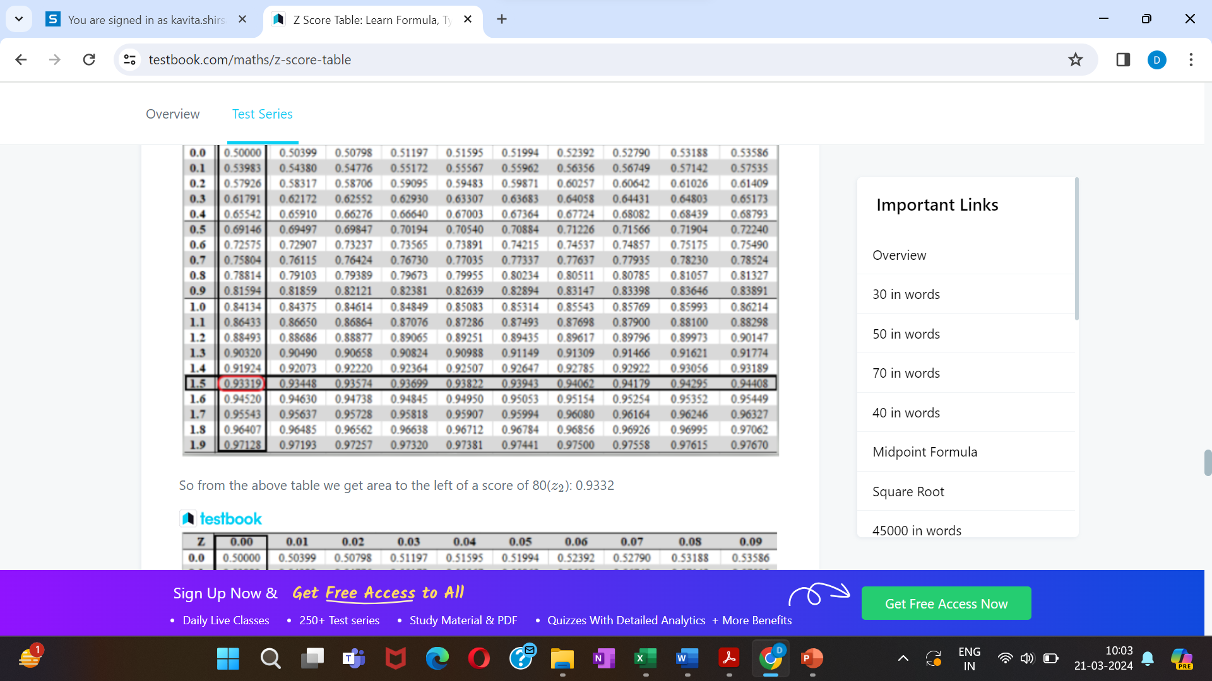

Slide 6
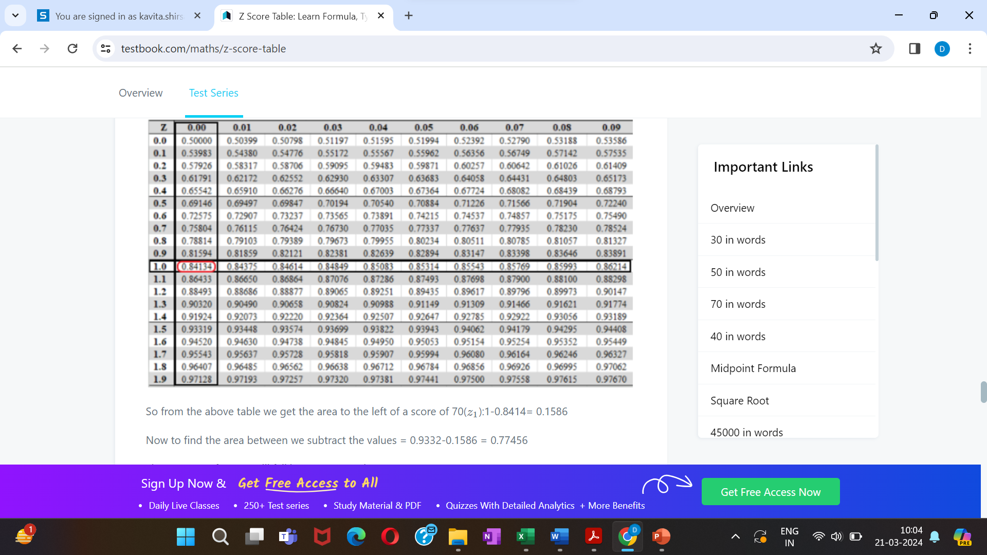

Slide 7
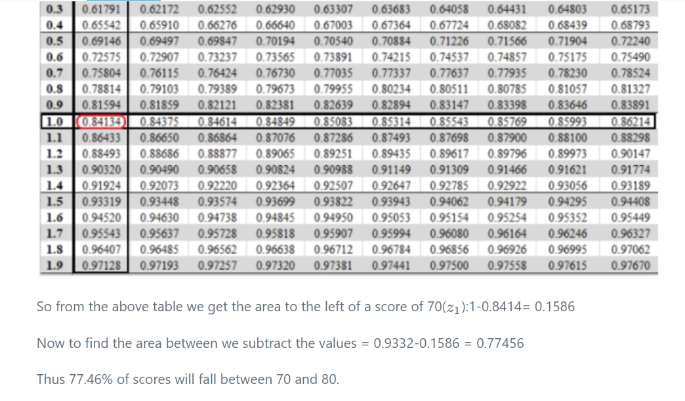

Slide 8
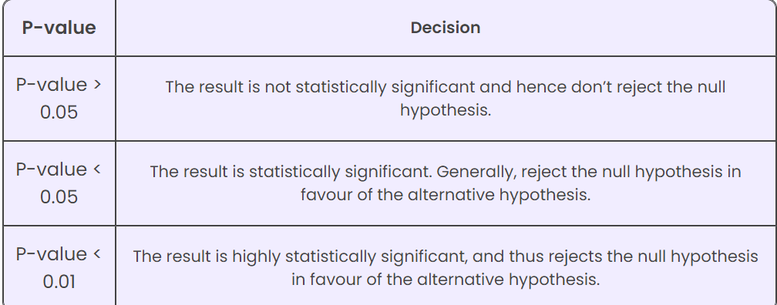
P-value Table
The P-value table shows the hypothesis interpretations:
Generally, the level of statistical significance is often expressed in p-value and the range between 0 and 1.
The smaller the p-value, the stronger the evidence, and hence, the result should be statistically significant.
Hence, the rejection of the null hypothesis is highly possible, as the p-value becomes smaller.

Slide 9
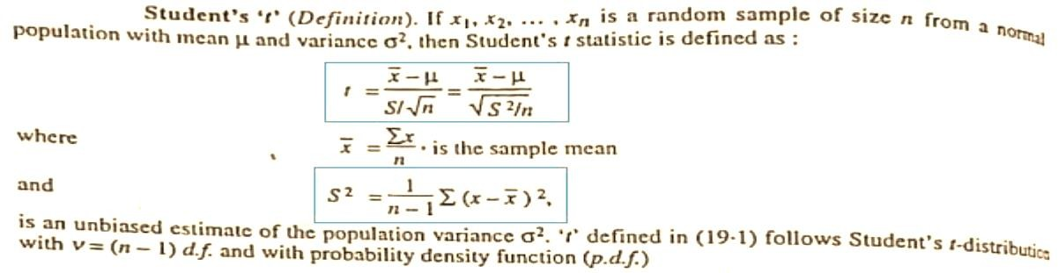

Slide 10
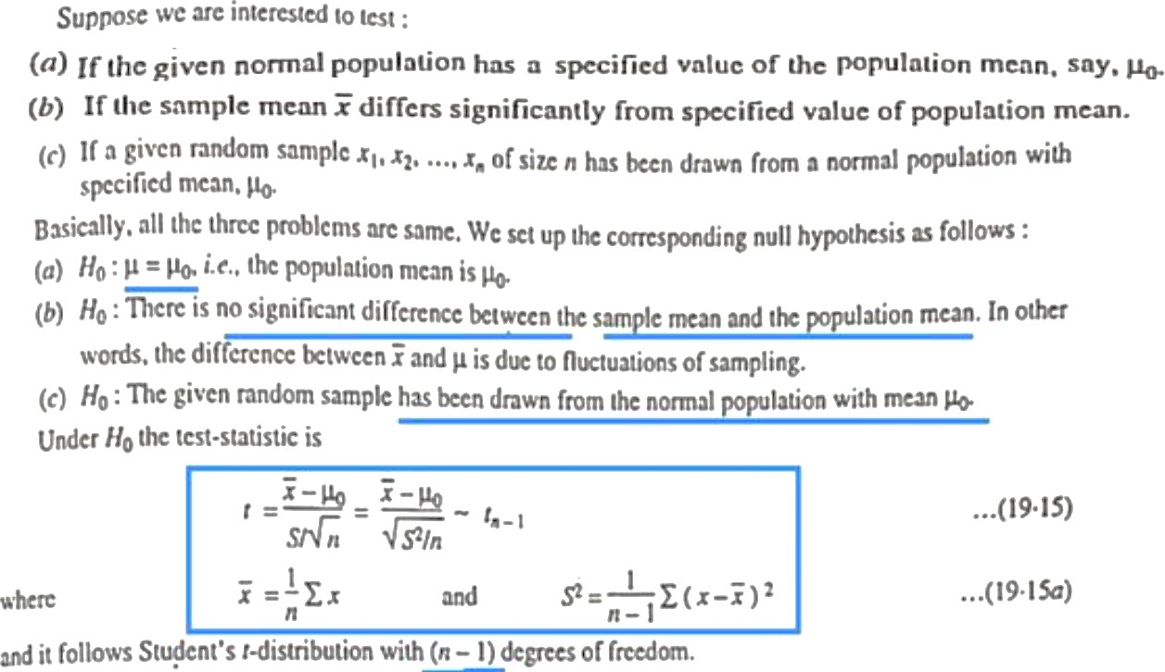

Slide 11
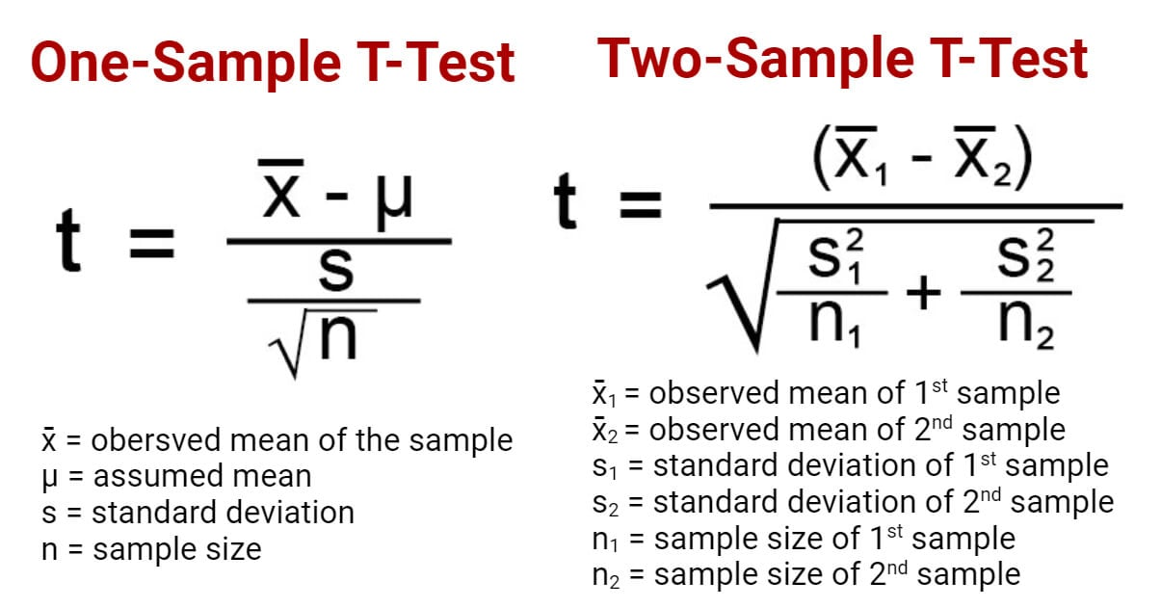

Slide 12
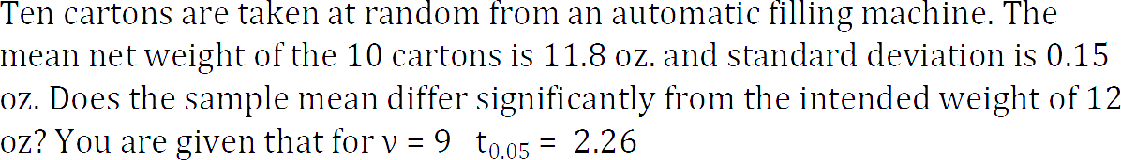
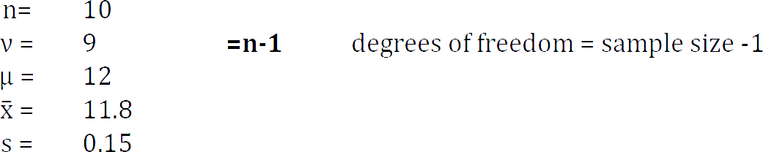

Slide 13
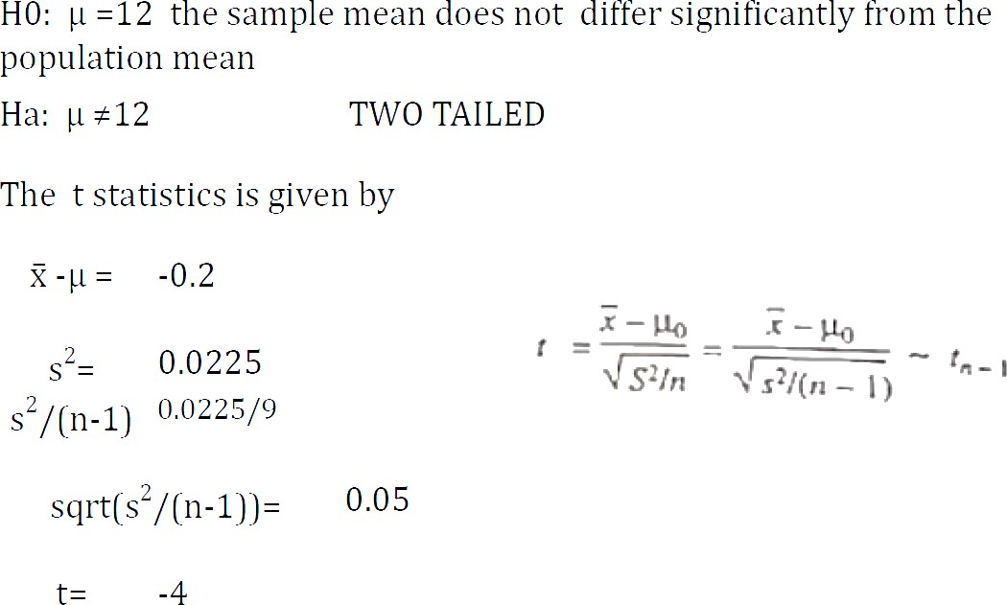

Slide 14
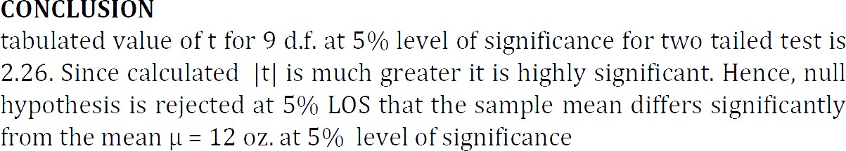

Slide 15

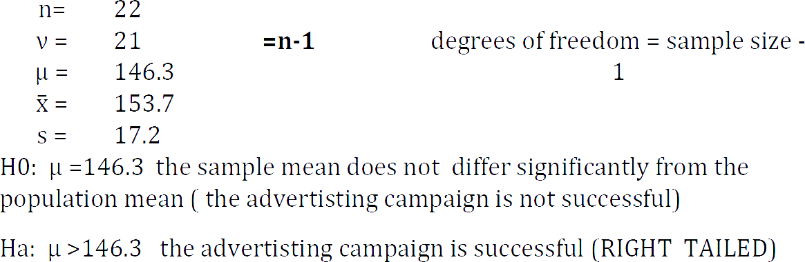

Slide 16
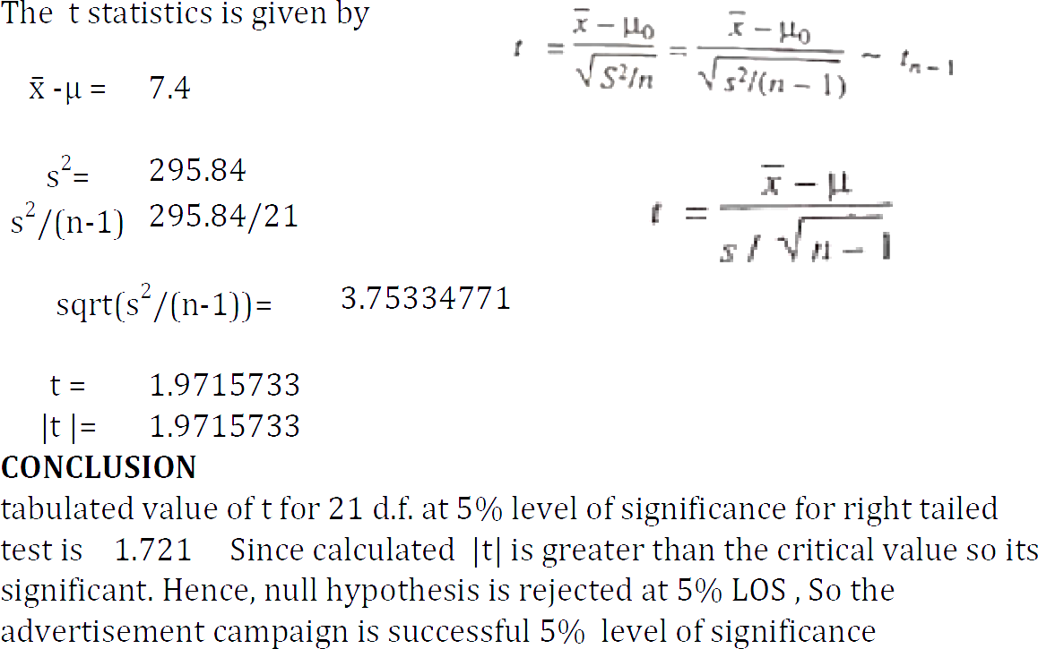

Slide 17
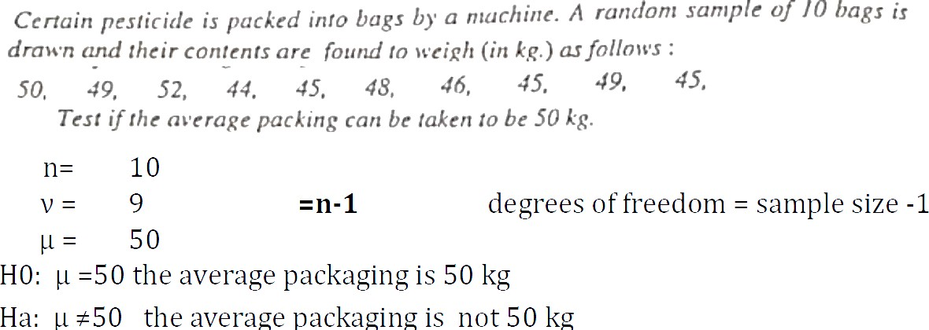

Slide 18
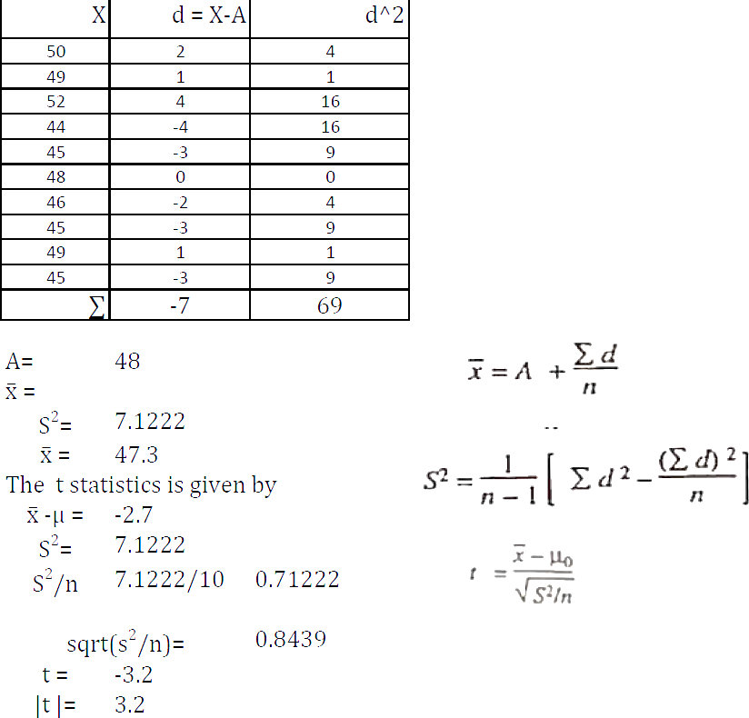

Slide 19
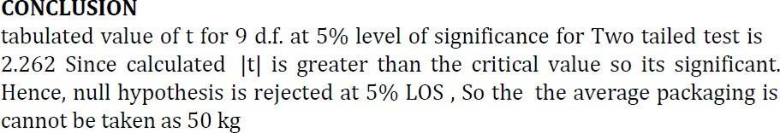

Slide 20
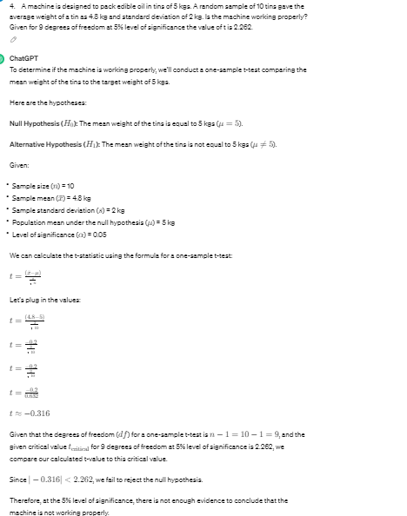
A machine is designed to pack edible oil in tins of 5 kgs. A random sample of 10 tins gave the average weight of a tin as 4.8 kg and standard deviation of 2 kg. Is the machine working properly? Given for 9 degrees of freedom at 5% level of significance the value of t is 2.262.

Slide 21
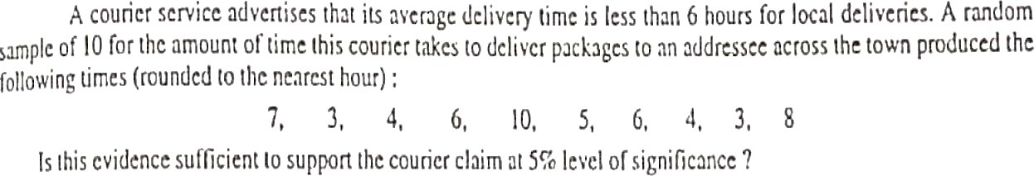

Slide 22
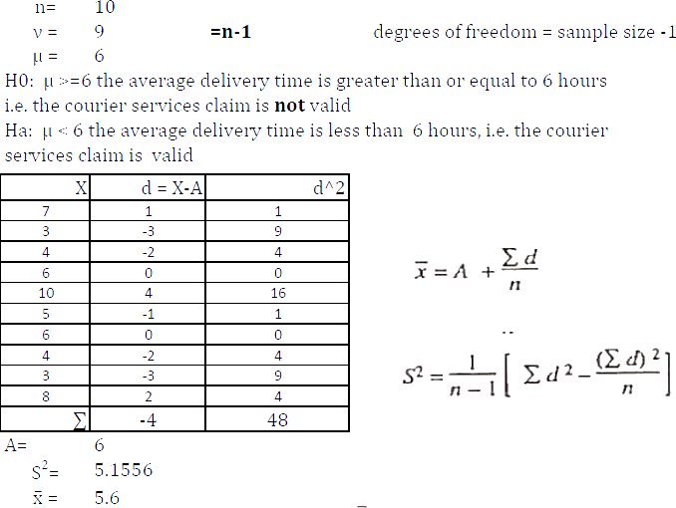

Slide 23
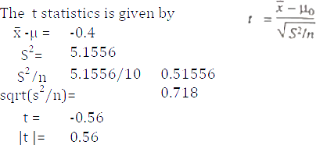

Slide 24
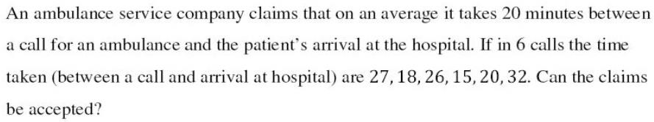

Slide 25
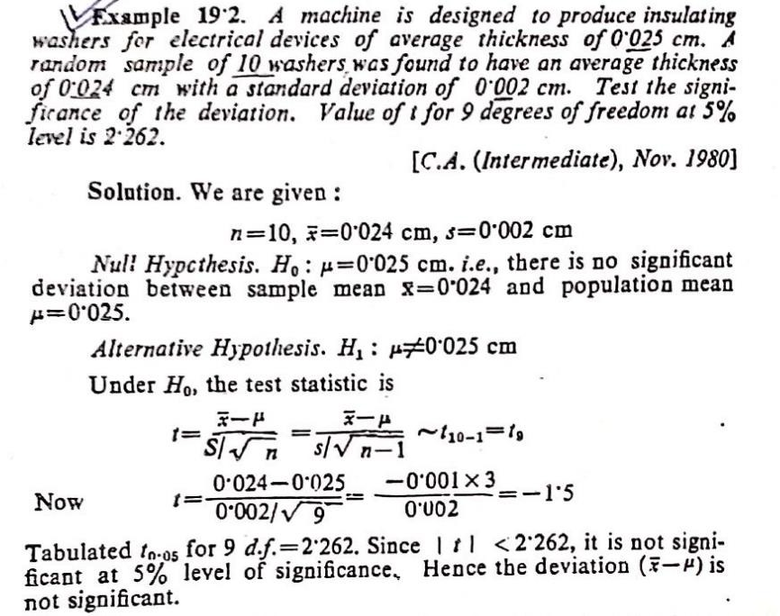

Slide 26
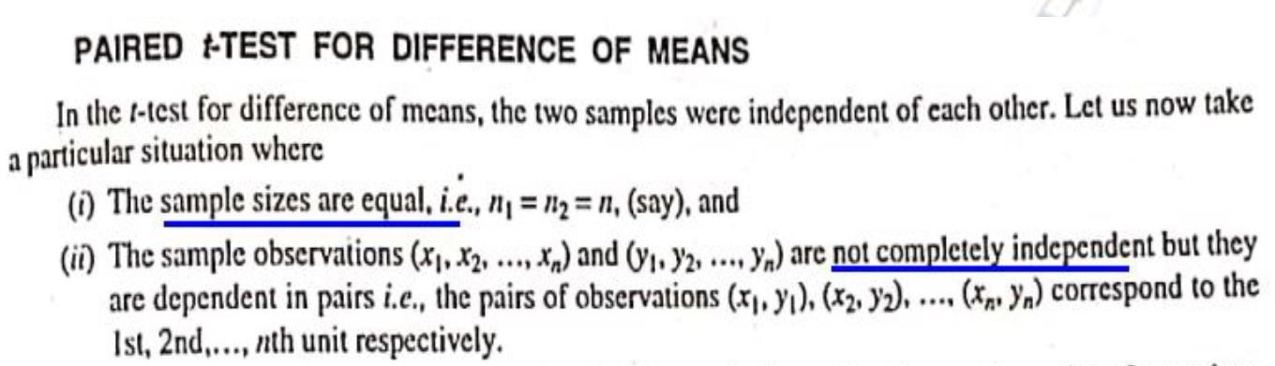

Slide 27
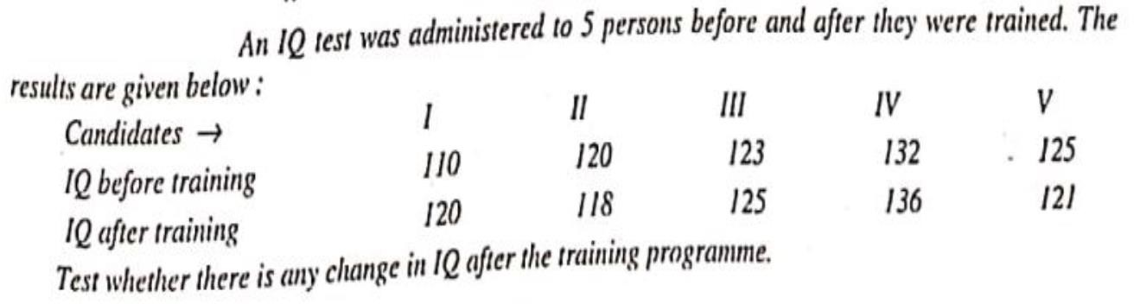

Slide 28
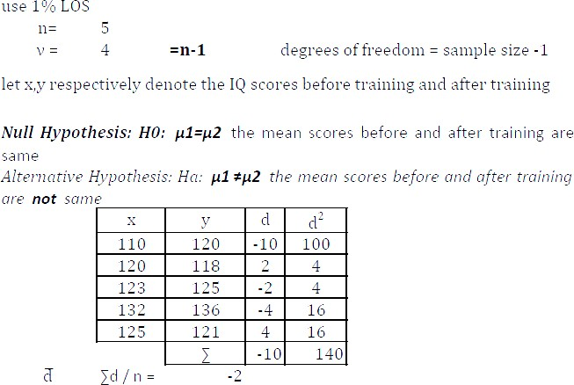

Slide 29
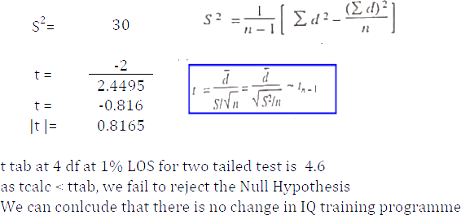

Slide 30
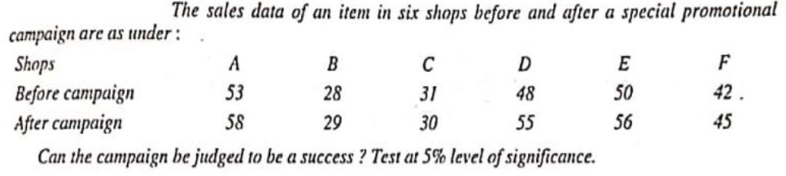

Slide 31
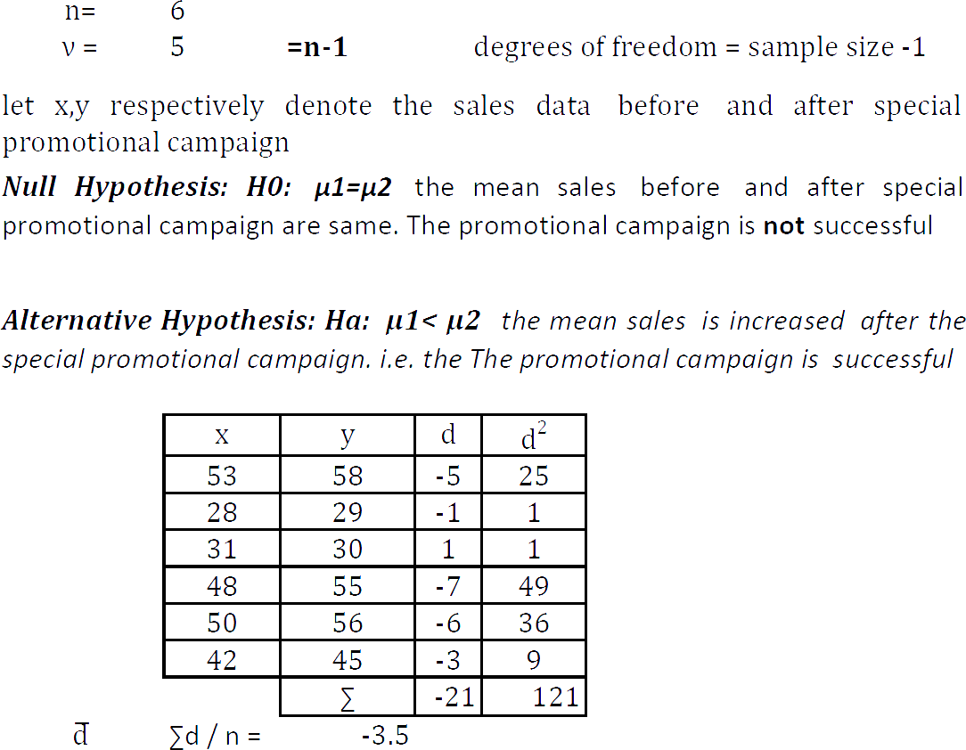

Slide 32
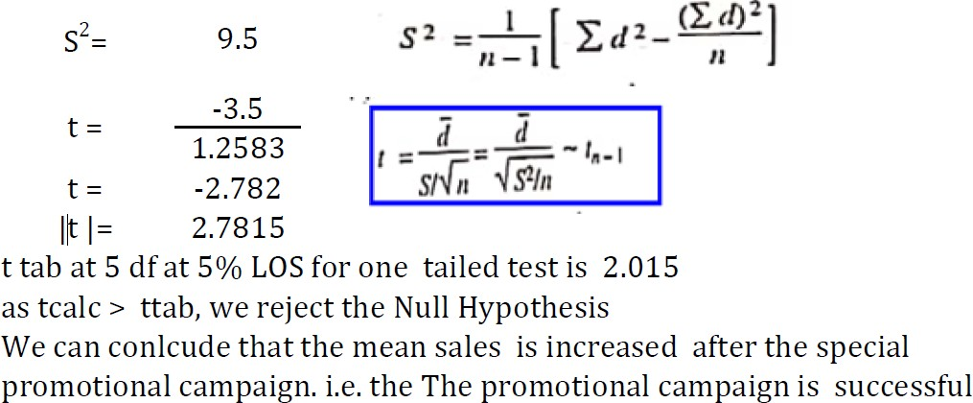

Slide 33
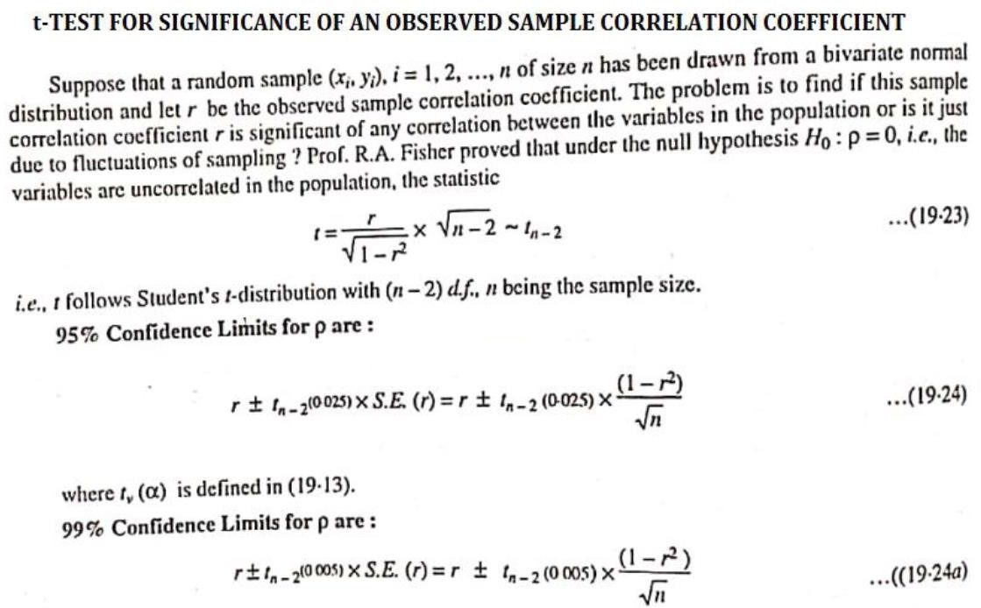

Slide 34
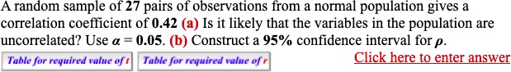

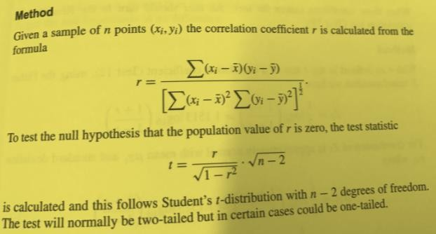

Slide 35
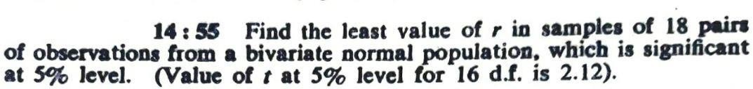
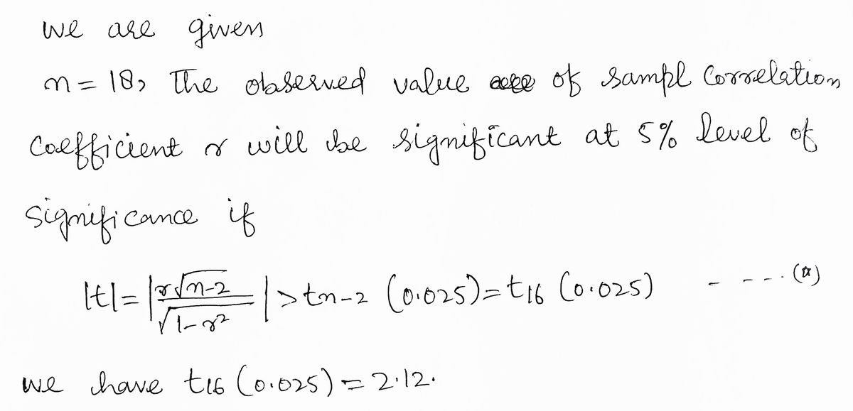

Slide 36
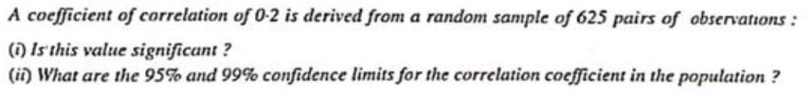

Slide 37
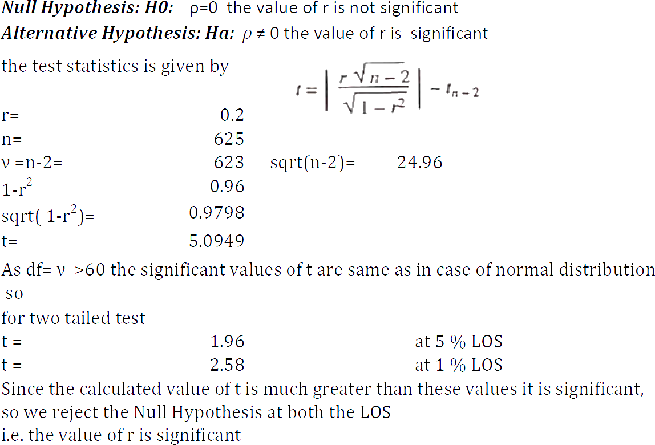

Slide 38
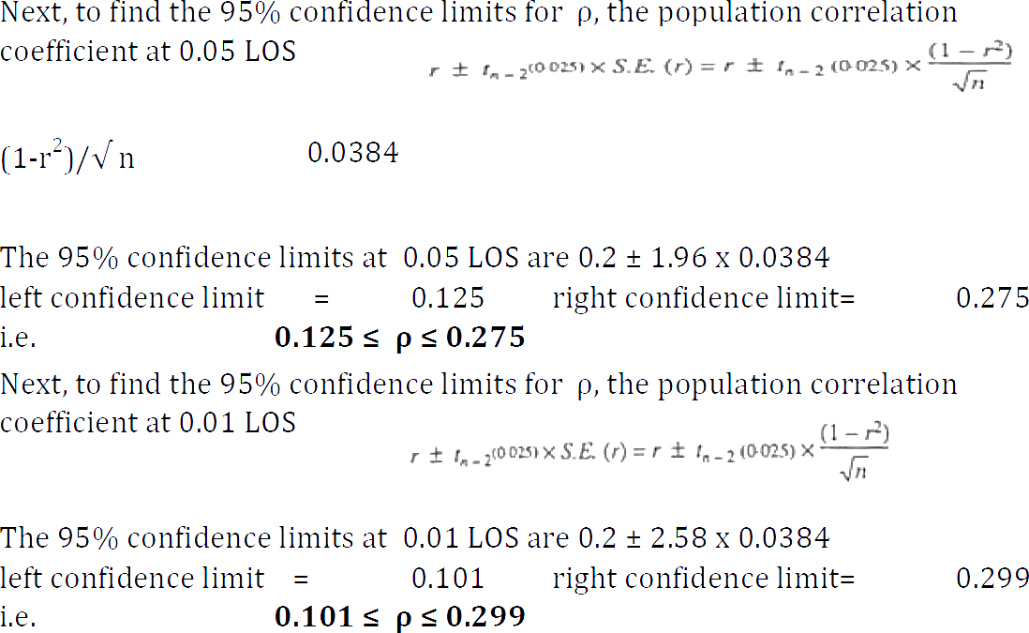

Slide 39
